Slide 1
Practical Attacks Against Graph-based Clustering
Yizheng Chen, Yacin Nadji, Athanasios Kountouras, Fabian Monrose, Roberto Perdisci, Manos Antonakakis, Nikolaos Vasiloglou

Slide 2
What this paper is about?
Problem
can an adversary, which with minimal knowledge evade detection;
can an adversary Generate and demonstrate low cost and effectiveness attack against Graph-based Clustering
Contributions
First practical attempt to attack graph-based modeling techniques
Two Novel Attacks:
targeted noise injection attack
small community attack
Cost analysis
Defenses

Slide 3
Results
Successful attack with minimal knowledge and low cost
attackers with no knowledge beyond their infections can render 84% of clusters too noisy to be useful, and evade clustering at a rate of 75%.
Were trained a Random Forest classifier with an average accuracy of 96.08%, and a false positive rate of 0.9%.
SVD rank = 35 -> Minimum cost = 0

Slide 4
What this paper is about?
Meaning
the first practical attempt to attack against graph-based clustering techniques, and a global feature space where realistic attackers without perfect knowledge.
were focused on adversarial clustering, which deals with global features that cannot be directly changed. Also capabilities of attackers with various knowledge levels, and quantify the costs associated with attacks were evaluated.

Slide 5
Motivation
Graph based network detection systems are not immune to adversarial attacks.
do an adversary with minimal knowledge can evade detection?

Slide 6
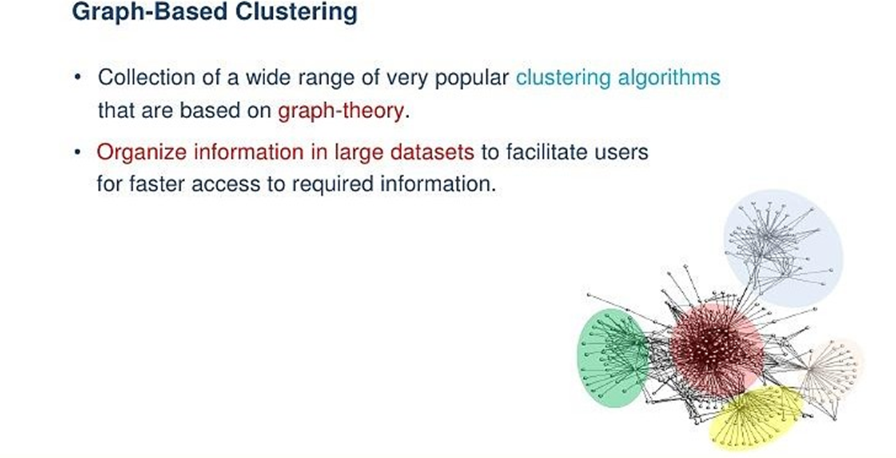
Background

Slide 7
Graph-based Clustering
Community discovery identifies criminal networks;
connected components track malvertising campaigns;
spectral clustering on graphs discovers botnet infrastructure;
hierarchical clustering identifies similar malware samples;
binary download graphs group potential malware download events;
newly devised graph embedding’s, like node2vec, could further improve upon the state of the art.

Slide 8
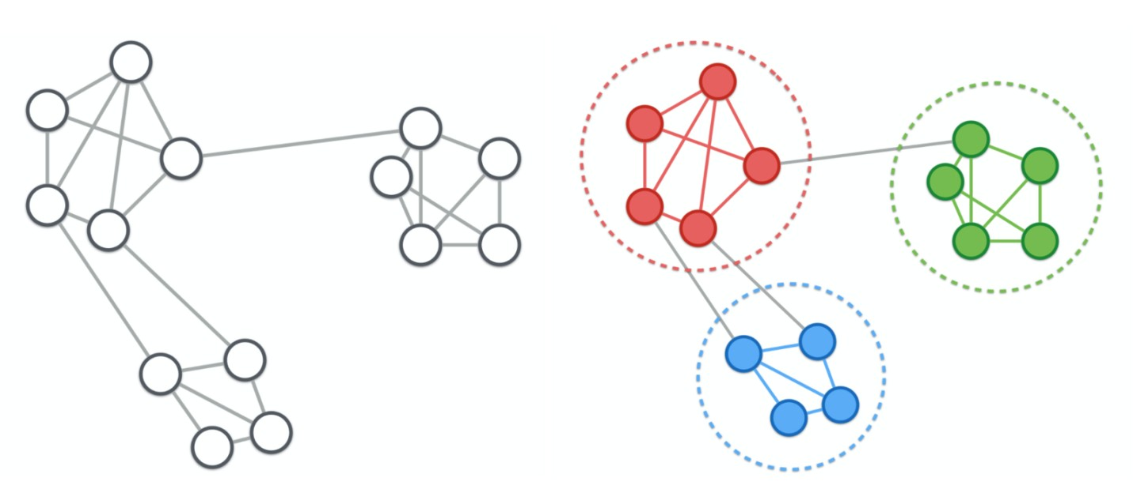
Graph based Clustering: Community Detection
Discovering groups in a network where individuals’ group memberships are not explicitly given.
Rely on a modularity metric to evaluate the quality of partitions, which measures the density of links inside and outside communities.
allows to optimize modularity to quickly find communities by using the Louvain algorithm.

Slide 9
Graph based Clustering: Spectral Methods
Spectral clustering techniques make use of the spectrum (eigenvalues) of the similarity matrix of the data to perform dimensionality reduction before clustering in fewer dimensions.
The goal of spectral clustering is to cluster data that is connected but not necessarily compact or clustered within convex boundaries.

Slide 10
Graph based Clustering: node2vec
the advantage of balancing homophily and structural equivalence in its embeddings.
proposes a sampling strategy by random walks starting from every vertex on the graph with the following parameters:
number of walks from each vertex;
length of each walk;
probability to return to the same vertex (Breadth First Search)
probability to explore out to further vertices (Depth First Search).

Slide 11
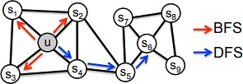
Graph based Clustering: node2vec

Slide 12
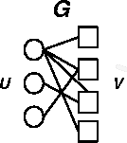
Threat Model & Attacks: Notation
An undirected bipartite graph is a special case where V can be divided into two disjoint sets (U and V ) such that every edge connects at a vertex in U and one in V , represented as G = (U,V, E).
(U ) = hosts, (V ) = query domains
G is an undirected graph that represents the underlying data a defender clusters.
An attacker controls an attacker graph, G⊂ G.
The adversary uses the targeted noise injection and the small community attacks described below to change G to G′, by adding or removing nodes and edges from G.

Slide 13
Threat Model
all attackers have at least one active infection, or G ⊂ G.
attacker can evaluate clusters like a defender can, e.g., manual verification.
an attacker has full knowledge of the features, machine learning algorithms, and hyperparameters used in both the unsupervised and supervised phases of the system under attack.

Slide 14


Attacker Knowledge Level: Minimal Knowledge
The attacker knows only about graph G, as well as any open source intelligence (OSINT).
An attacker with minimal knowledge can draw information from their infected hosts.
The attacker can use OSINT to select potential data to inject as noise, or can coordinate activities between their vertices in G.

Slide 15
Attacker Knowledge Level: Moderate Knowledge
The moderate knowledge case represents an adversary with ˜G , an approximation of G.
An attacker with moderate knowledge is similar to a sophisticated adversary with access to large datasets through legitimate (i.e., commercial data offerings) or illegitimate (i.e., security compromises) means.

Slide 16

Attacker Knowledge Level: Perfect Knowledge
An adversary can completely reconstruct the clustering results of the defender to evaluate the effectiveness of their attacks.

Slide 17
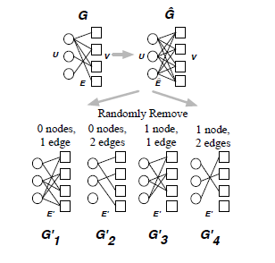
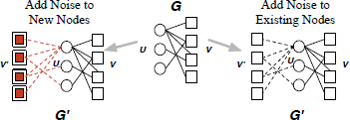
Attacks
two novel attacks against graph clustering;
Targeted noise injection, improves on random injections by emulating the legitimate signal’s graph structure;
Small community attack, exploits the known phenomenon of small communities in graphs

Slide 18
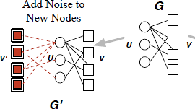
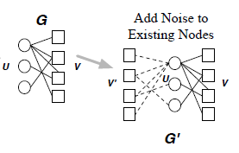
Targeted Noise Injection
the purpose of noise injection is mirroring real edges.
bipartite attacker graph G
vertex sets U (circles)
V (squares)
G -> G′
attack function f : (u,v) ∈ E 7→ (u,v′) ∈ E′
This creates G′ = (U,V ∪V ′, E ∪ E′)

Slide 19
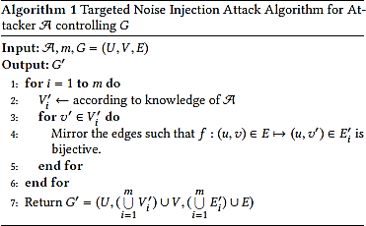


Targeted Noise Injection
the attacker graph G
noise level m

Slide 20
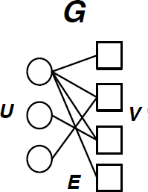
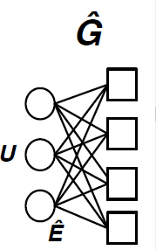
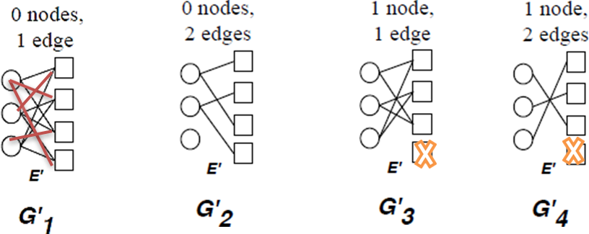
Small Community
an adversary first constructs a complete version of G, Ĝ
removes edges and/or nodes
minimal knowledge -> nv nodes and ne edges randomly

Slide 21
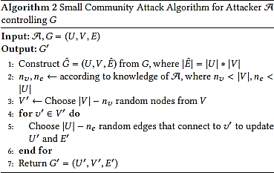

Small Community
Algorithm 2 formally shows the the small community attack A in control of graph G.

Slide 22
Attacks in Practice: Pleiades
Pleiades is a network detection system that groups and models unsuccessful DNS resolutions from malware that employ domain name generation algorithms (DGAs) for their command and control (C&C) communications. The system is split into two phases:
First, an unsupervised process detects new DGA families by clustering a graph of hosts and the domains they query.
Second, each newly detected cluster is classified based on the properties of the generated domains.

Slide 23
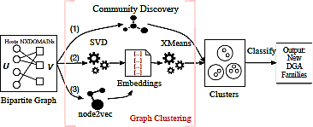
Attacks in Practice: Pleiades
commercially deployed and relies on graph modeling
Why?

Slide 24
Datasets
Used for construct Host-NXDOMAIN Graph as ground truth without attack.
Collected from anonymized recursive DNS traffic from a large telecommunication company from December 18, 2016 to December 29, 2016.
contains NXDOMAINs queried by hosts and the query timestamps.
262 thousand unique anonymized hosts, with 44.6 million queries to 1.8 million unique NXDOMAINs in a day
available to defenders and perfect knowledge attackers.

Slide 25
Datasets
Used as a surrogate network dataset.
NXDOMAIN traffic from a large US university network collected on December 25, 2016.
contains 8,782 hosts and 210 thousand unique NXDOMAINs.
available to attackers with moderate and perfect knowledge.

Slide 26
Datasets
reverse engineered DGA domains:
for 14 malware families
labeled 267 clusters belonging to four malware families
Were trained a Random Forest classifier with an average accuracy of 96.08%, and a false positive rate of 0.9%.

Slide 27
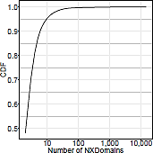
Attack Costs
anomaly cost for noise injection -> by computing the cumulative distribution functions (CDF)
adversarial cost behind the small community attack -> by change of attacker graph density D(G′)

Slide 28
Results
select hyperparameters
results for both attacks against each graph based clustering technique, for the three knowledge levels
the costs incurred by the attacker, and how these can be used to identify possible defenses.

Slide 29
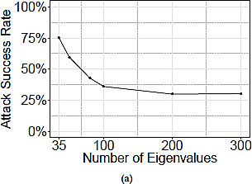
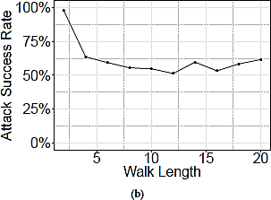
Choosing Hyperparamters
for the graph clustering methods in Pleiades to ensure high quality clusters are generated.

Slide 30
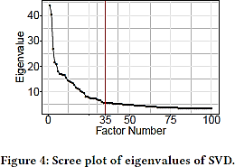
Spectral Clustering
choosing the rank of SVD
Why?

Slide 31
Community Discovery
the best partition method from the NetworkX community discovery library
Louvain algorithm
extracts good communities on the graph by optimizing the modularity metric
scales to large network with hundreds of millions of nodes

Slide 32
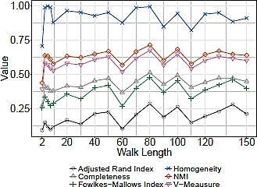
node2vec.
traditional cluster validity metrics:
Adjusted Rand Index
Completeness
Fowlkes-Mallows index
Homogeneity
Normalized Mutual Information (NMI)
V-Measure score
walk length

Slide 33
Targeted Noise Injection
Four DGA families were identified:
Pykspa
Suppobox
Murofet
Gimemo.
For each extracted:
the attacker graphs (G)
the target domains (V )

Slide 34
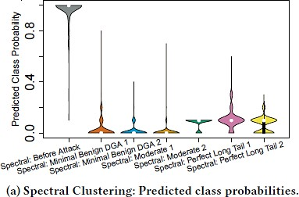
Spectral Clustering
267 DGA clusters from the four malware families across 12 days

Slide 35
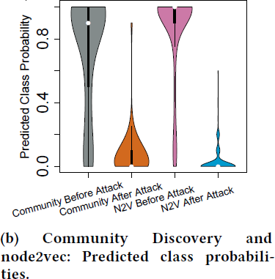
Community Discovery
used the same set of DGA domains labeled in Spectral Clustering for evaluation

Slide 36
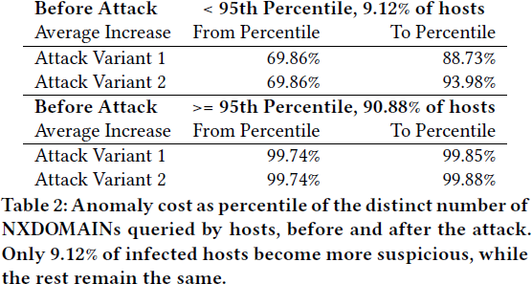
Targeted Noise Injection Costs
anomaly cost -> by measuring the infected host percentile of the NXDOMAIN distribution

Slide 37
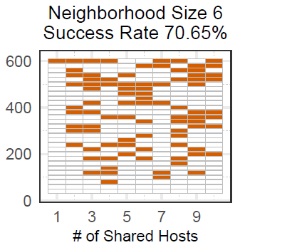
Small Community
Spectral Clustering
choosen a group of 618 domains and 10 infected hosts belonging to Suppobox
success rate 75%+.
Community Discovery
High cost
Results do not computed
Node2vec
success rate 70%+.

Slide 38
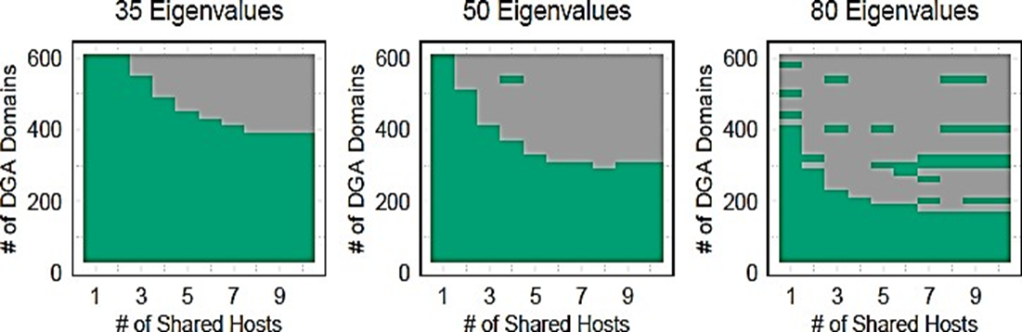
Small Community

Slide 39
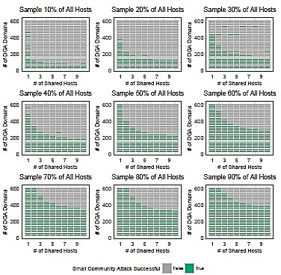
Size of Network
the number of nodes (hosts and domains)
the number of edges (the query relationship).

Slide 40
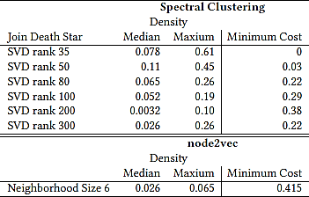
Agility Cost
SVD rank = 35 -> Minimum cost = 0
neighborhood sizes 2, 4, and 6 -> attack
success rate 65.16%, 60.65%, and 70.65%

Slide 41
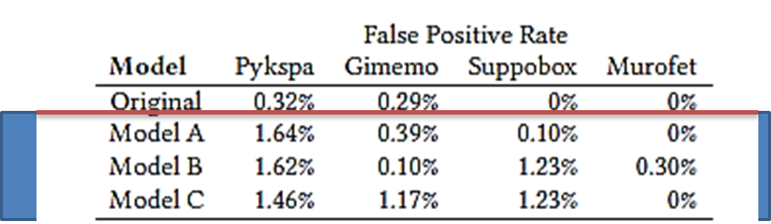
Defense
Training Classifier with Noise
By retraining the classifier, it becomes more resistant to noise that could be injected by the adversary in the unsupervised phase of Pleiades.
It is important to note that this defense only trains the classifier with noise that has been witnessed.

Slide 42
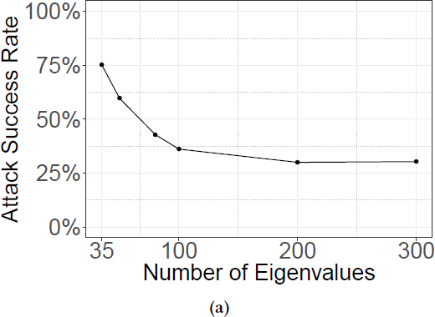
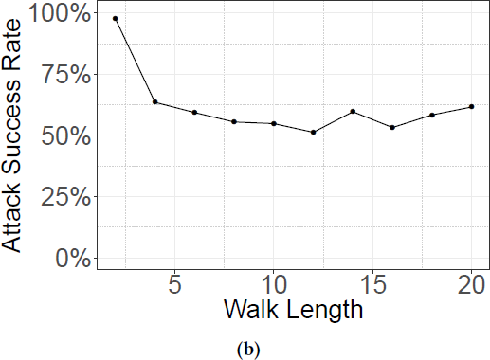
Improving Hyperparameter Selection
neighborhood size and walk length are not optimal hyperparameters.
We can choose more resistant hyperparameters

Slide 43
Conclusions
the first practical attempt to attack against graph- based clustering techniques and a global feature space where realistic attackers without perfect knowledge.
As a result were designed and evaluated two novel graph attacks against a state-of-the-art network level, graph-based detection system.
Low Attack Cost
were focused on adversarial clustering, which deals with global features that cannot be directly changed.
Defenses.

Slide 44
Questions

